Slide 1
“ E-Commerce Ecosystem “

Slide 2
Project contents
01
Data Collection
02
Read& Understanding Data
03
Exploratory Data Analysis (EDA)
04
Pre-Processing

Slide 3
01
Data Collection

Slide 4

Data.GOV :
https://catalog.data.gov/dataset/state-agency-amazon-spend-fiscal-year-25

Slide 5
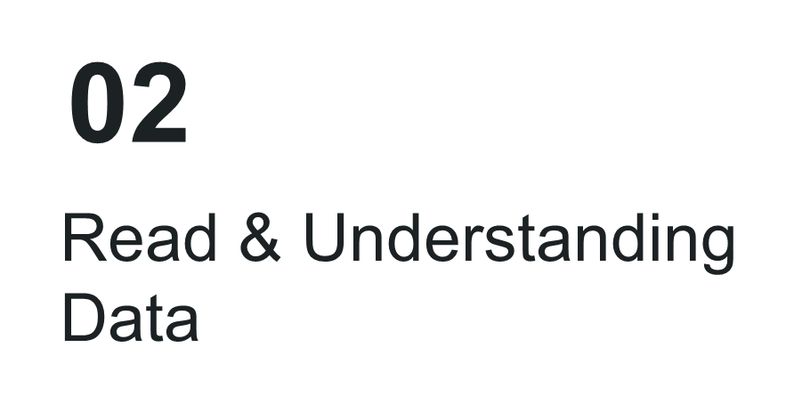

Slide 6
Describe Data :
Order Date: The date on which the order was placed.
Agency Name: The name of the agency handling or processing the order.
Payment Date: The date when the payment was made.
Payment Amount: The total amount paid for the order.
Shipment Date: The date when the order was shipped.
Product Category: The category or type of product purchased.
ASIN: Amazon Standard Identification Number, a unique identifier for each product.
Title: The name or description of the product.
UNSPSC: United Nations Standard Products and Services Code, a global classification system for products and services.
Brand Code: A code representing the brand of the product.
Brand: The name of the brand.
Manufacturer: The entity that manufactures the product.
Item Model Number: The model number of the item.
Part Number: A unique number assigned to each part of a product.
Product Condition: The condition of the product (e.g., new, used).

Slide 7
Describe Data :
Listed PPU: The price per unit as listed.
Purchase PPU: The price per unit at purchase.
Item Quantity: The number of units purchased.
Item Subtotal: The subtotal amount for the items purchased before any additional charges.
Item Shipping & Handling: The cost associated with shipping and handling.
Item Promotion: Any promotional discount applied to the item.
Item Tax: The tax amount applied to the item.
Item Net Total: The total amount for the item after discounts, shipping, and taxes.
Discount Program: Information about any discount programs applied.
Pricing Discount Applied ($ off): The discount amount applied in dollars.
Pricing Discount Applied (% off): The discount percentage applied.
Seller Name: The name of the seller.
Order Day: The day of the week when the order was placed. (Extract)
Order Delivery Time: The time taken for the order to be delivered. (Extract)
Time to Purchase: The time elapsed from when the product was listed to when it was purchased. (Extract)
Seller profit: seller's earnings after deducting all costs from a sale. (Extract)

Slide 8
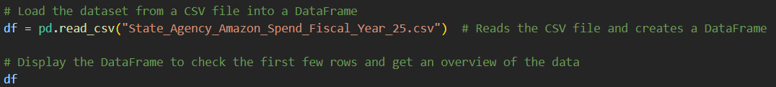
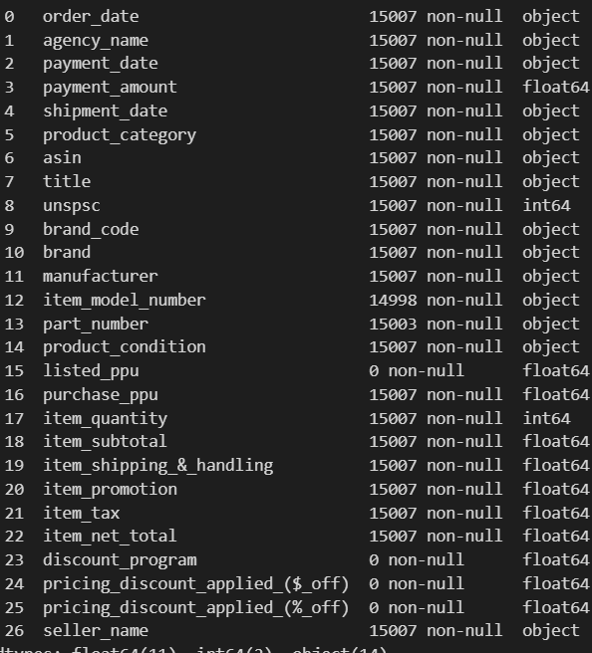
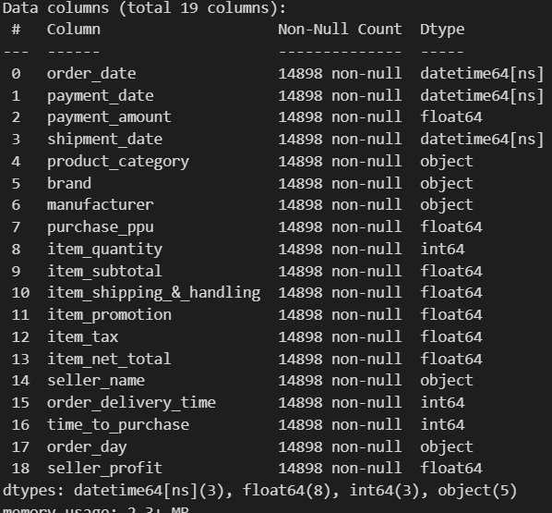
Read CSV & Check Dtype :

Slide 9
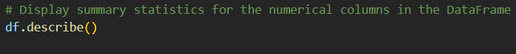
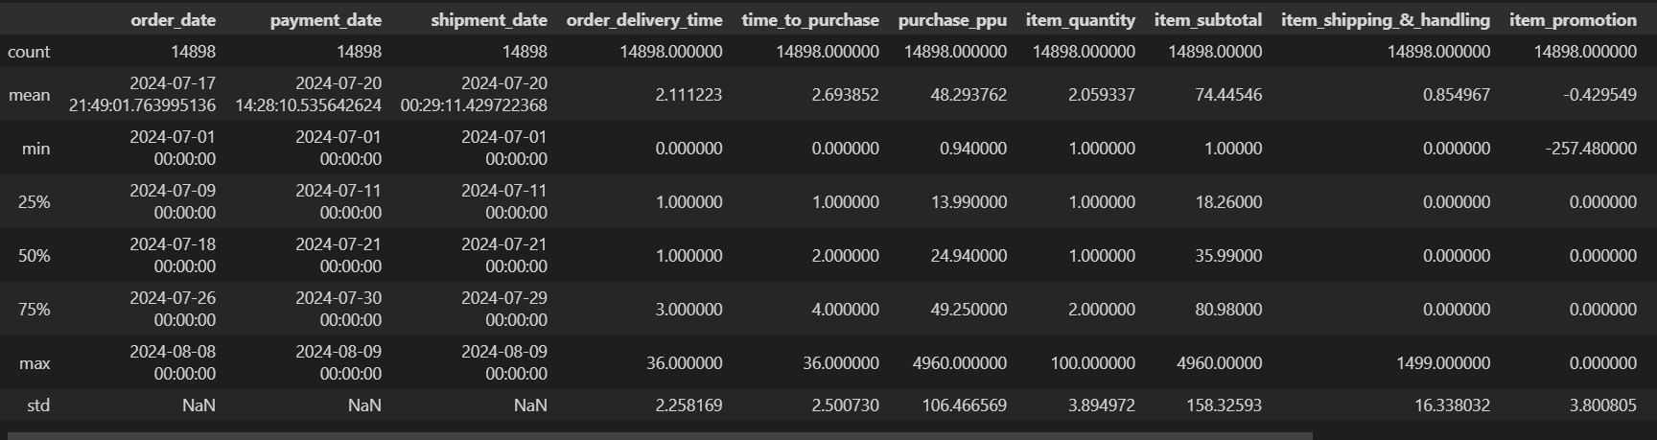
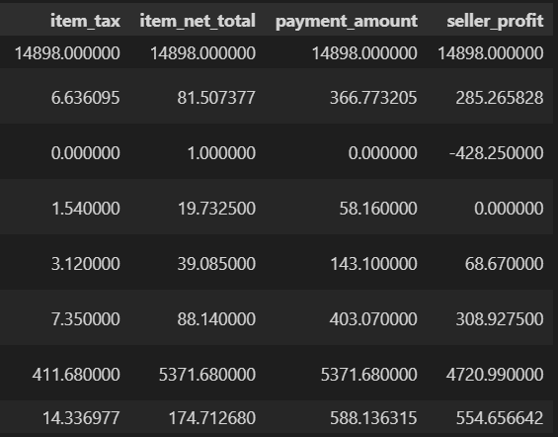
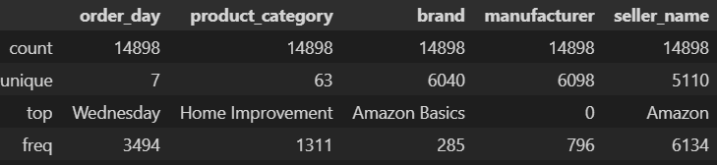

Slide 10
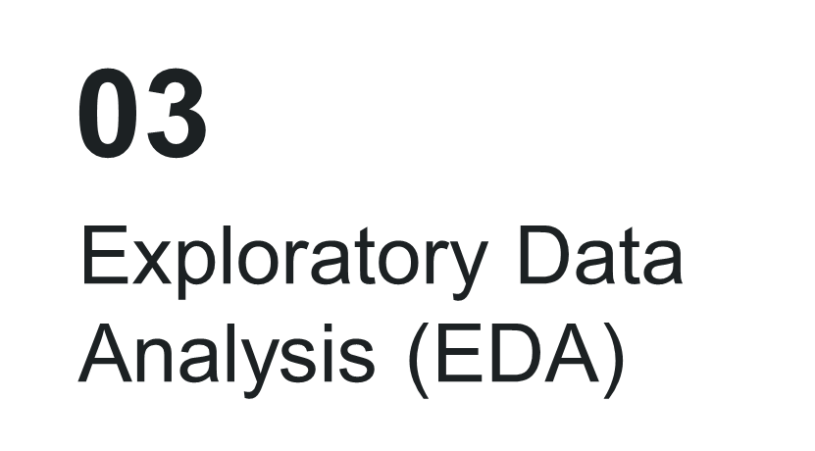

Slide 11
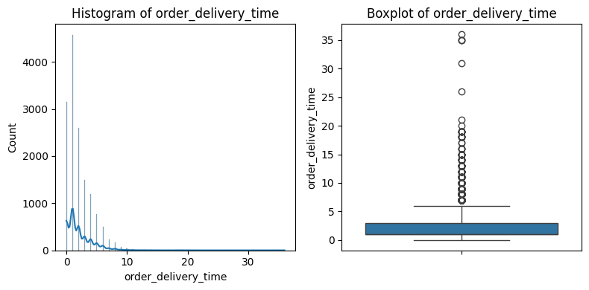
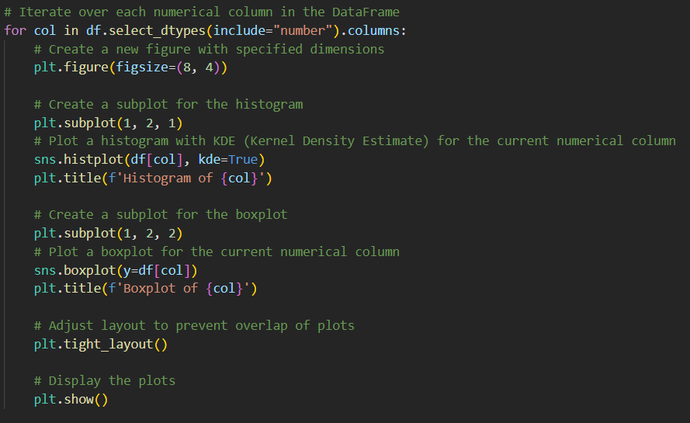
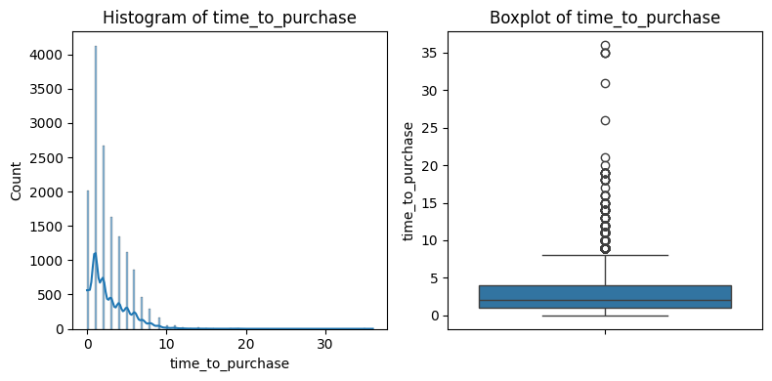
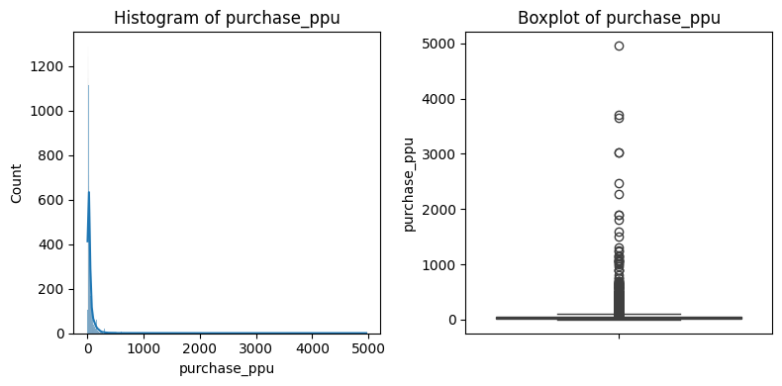
Uni-variate Analysis :

Slide 12
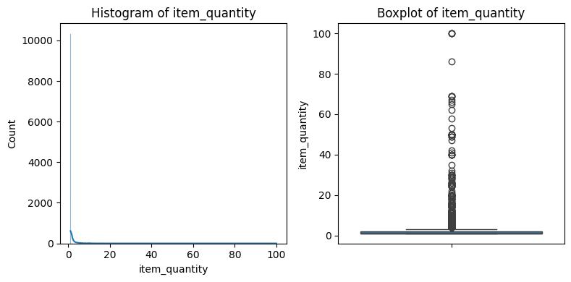
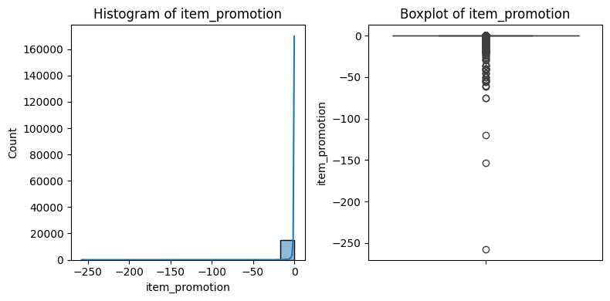
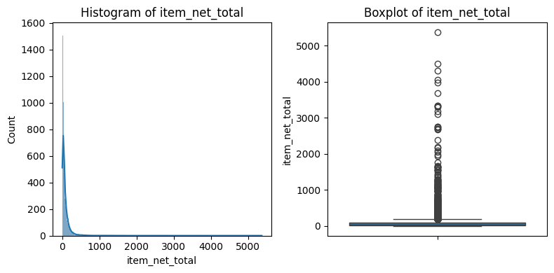


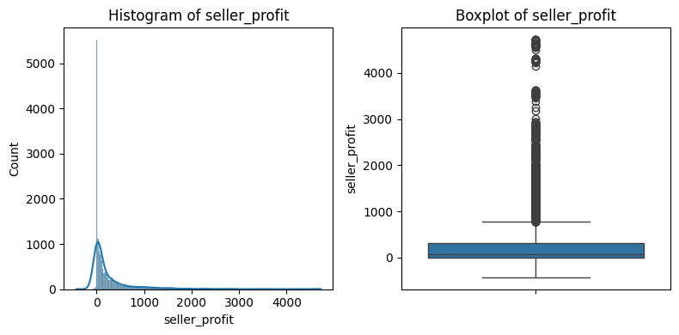
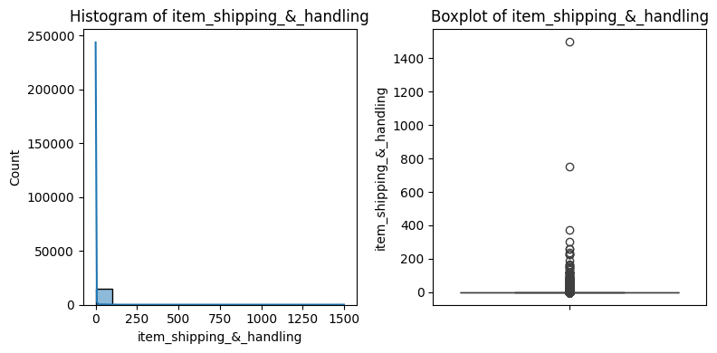
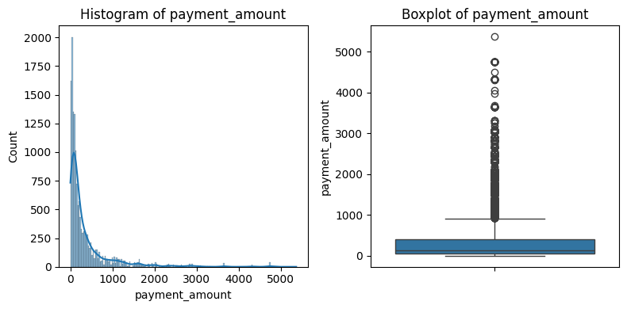

Slide 13
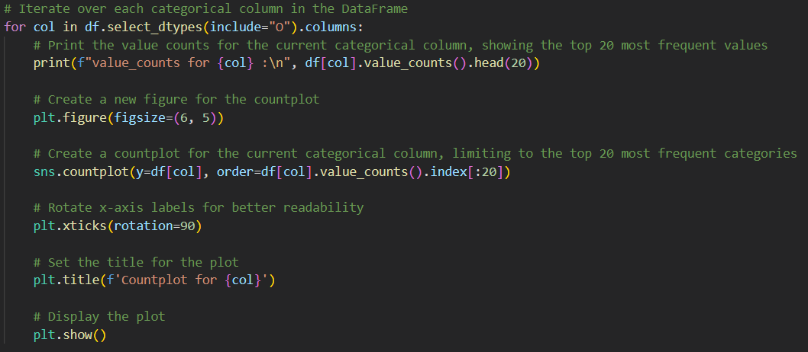
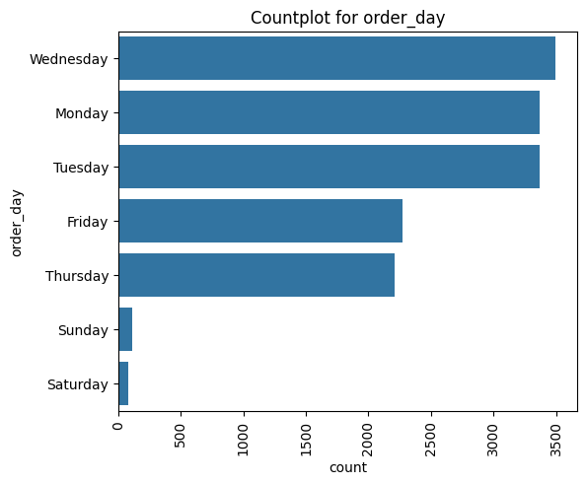
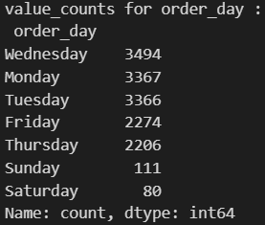

Slide 14
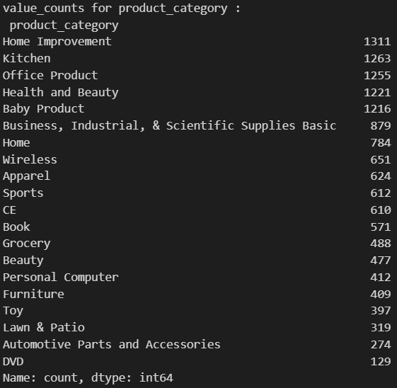
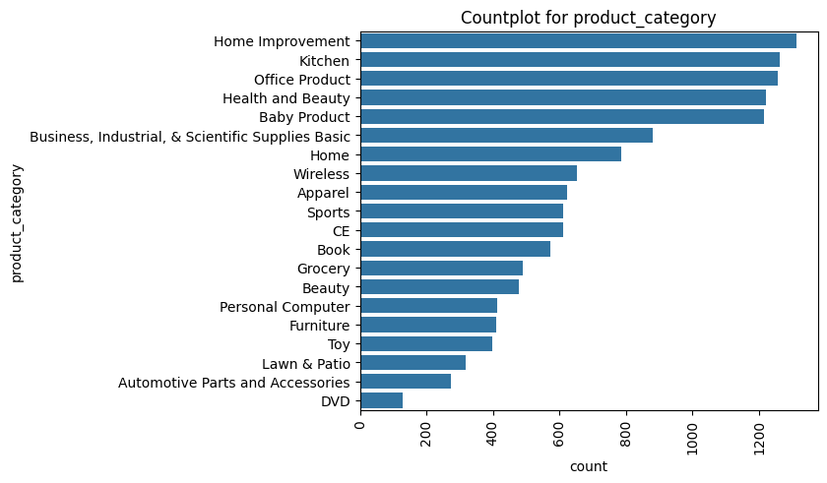
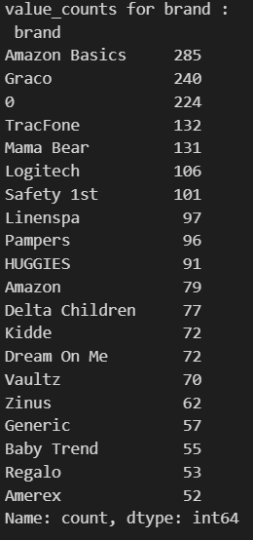
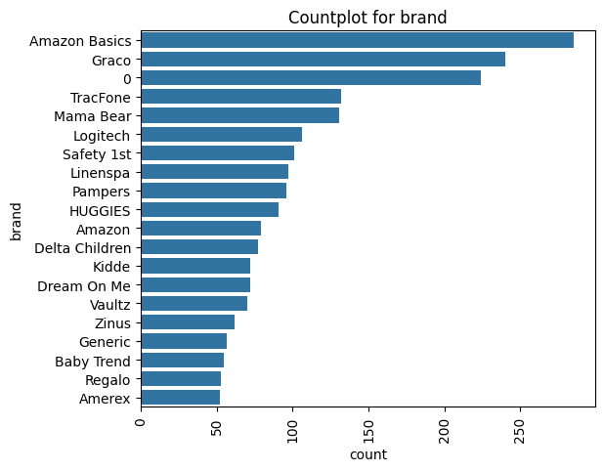

Slide 15
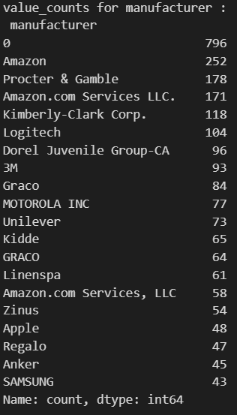
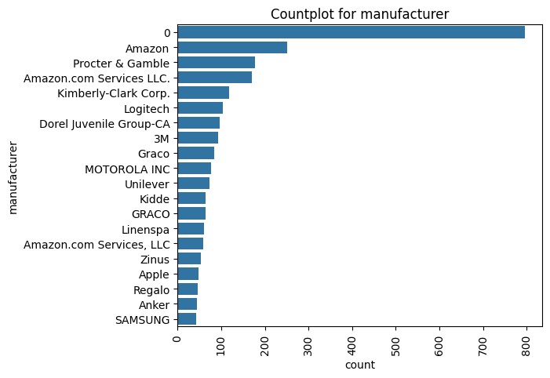
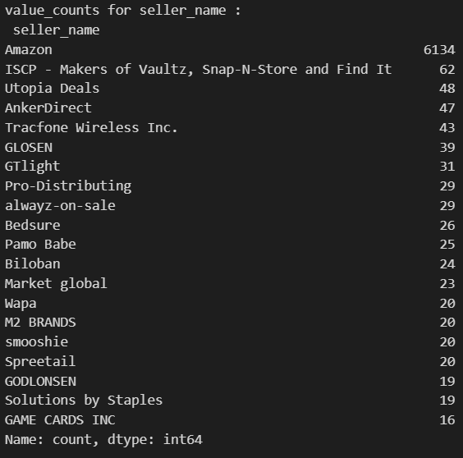
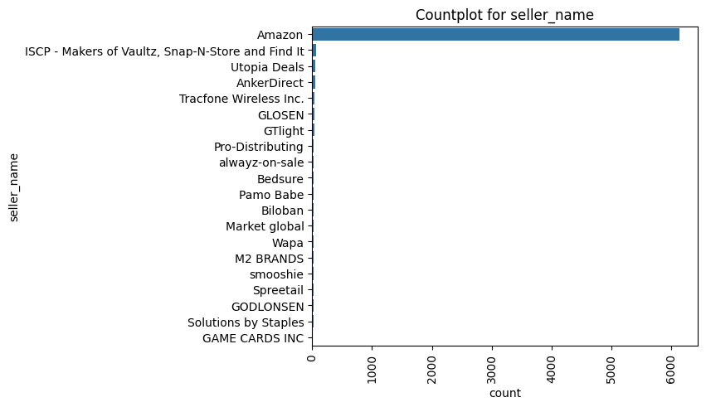

Slide 16
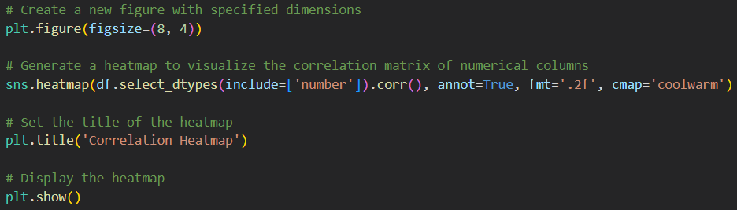
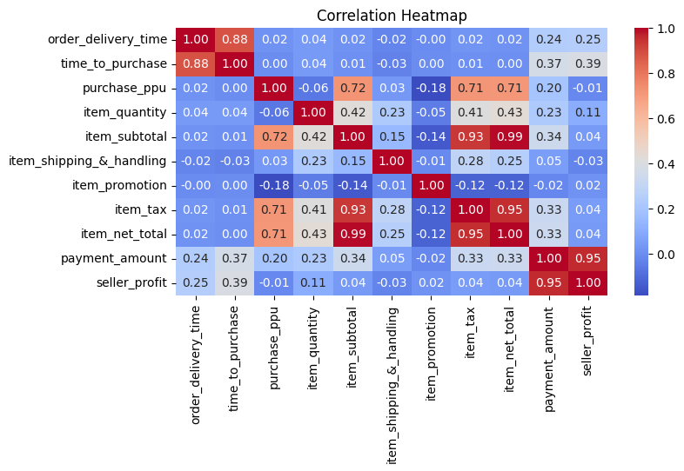
Bi-Variate Analysis :

Slide 17
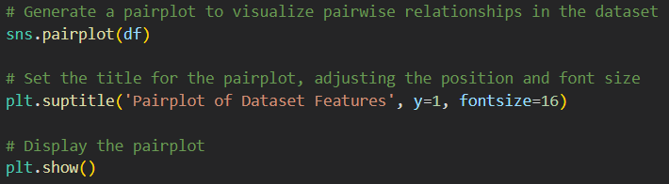
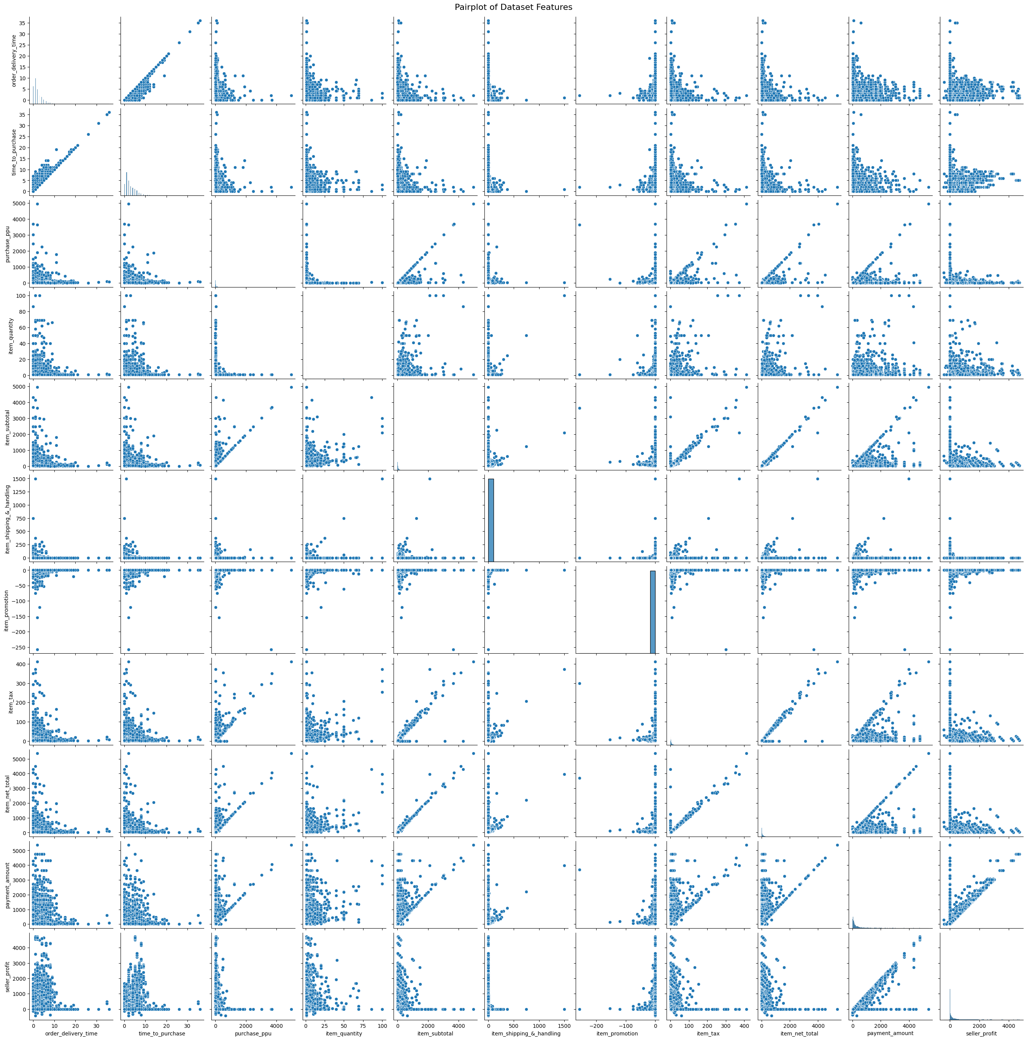
Multi-Variate Analysis :

Slide 18
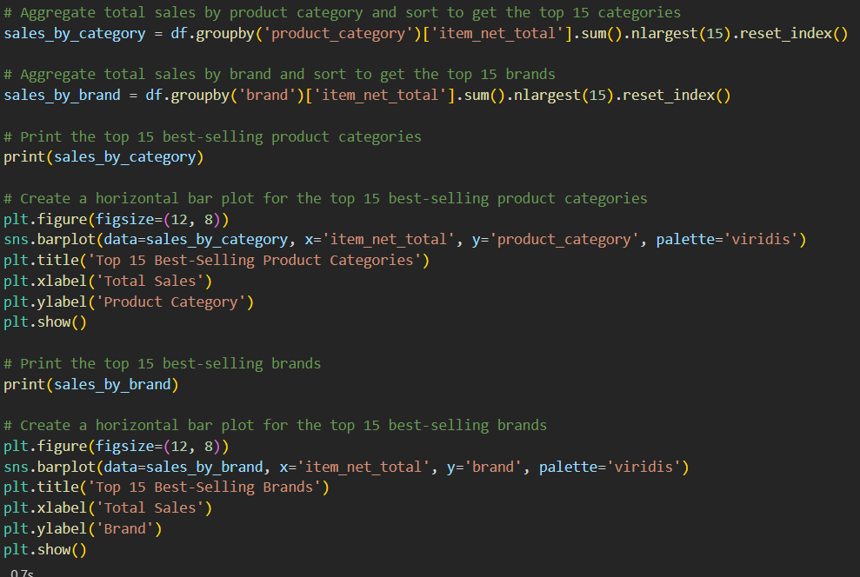
Business Question :
1) What are the best-selling product categories and brands?

Slide 19
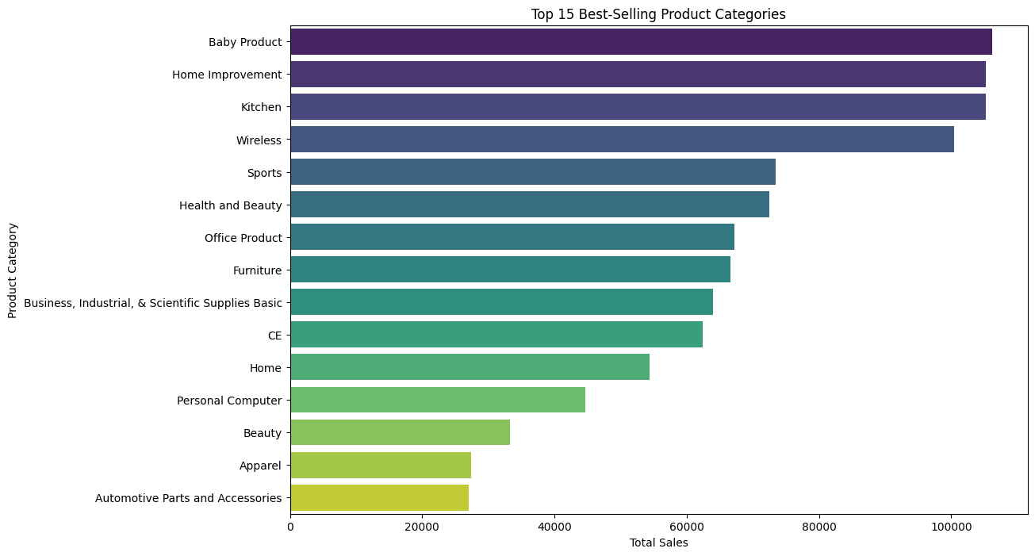
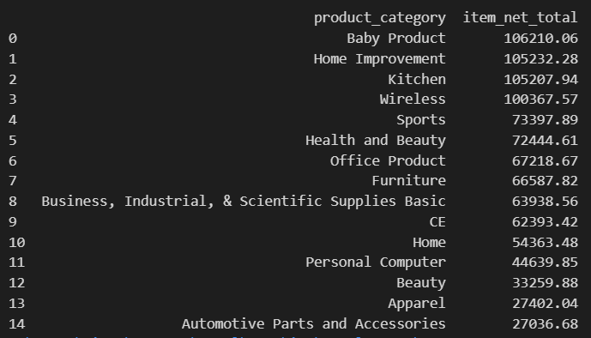
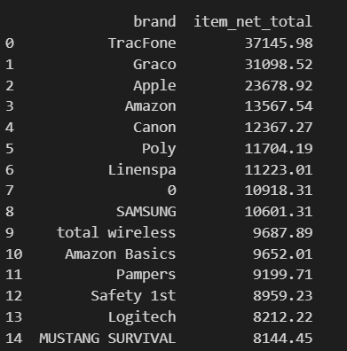
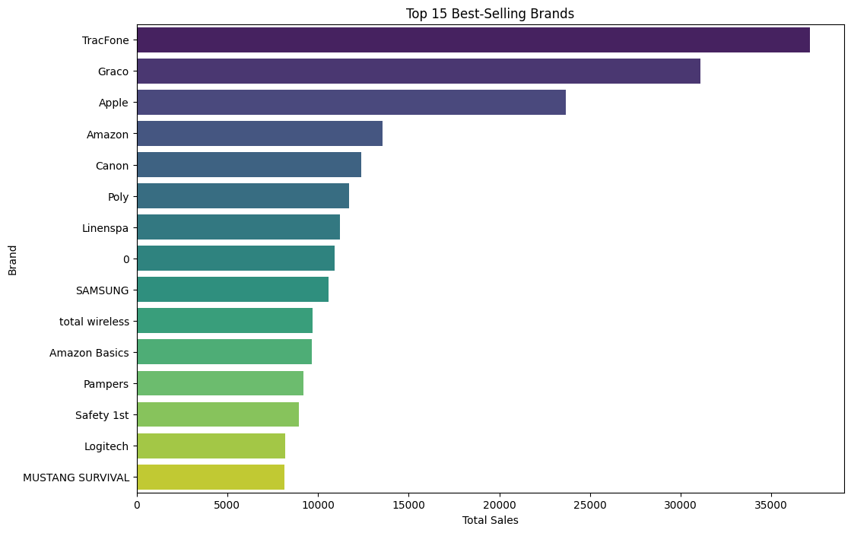

Slide 20
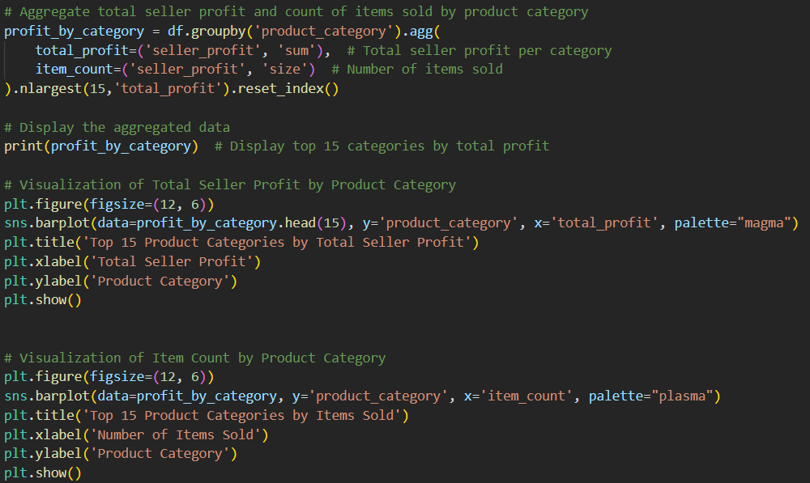
2) How does seller profit vary across different product categories?

Slide 21
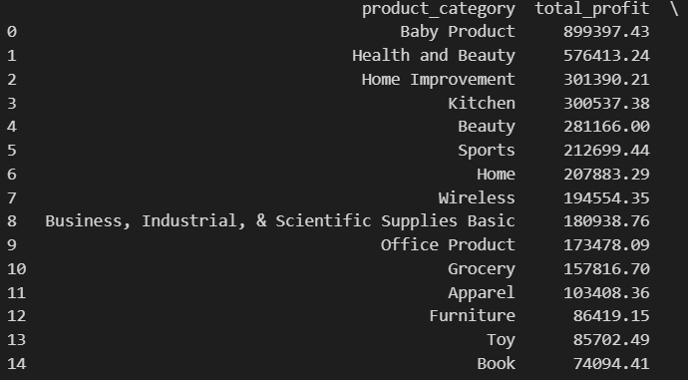
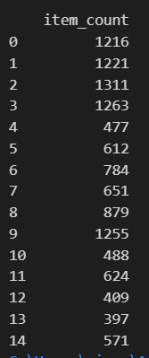
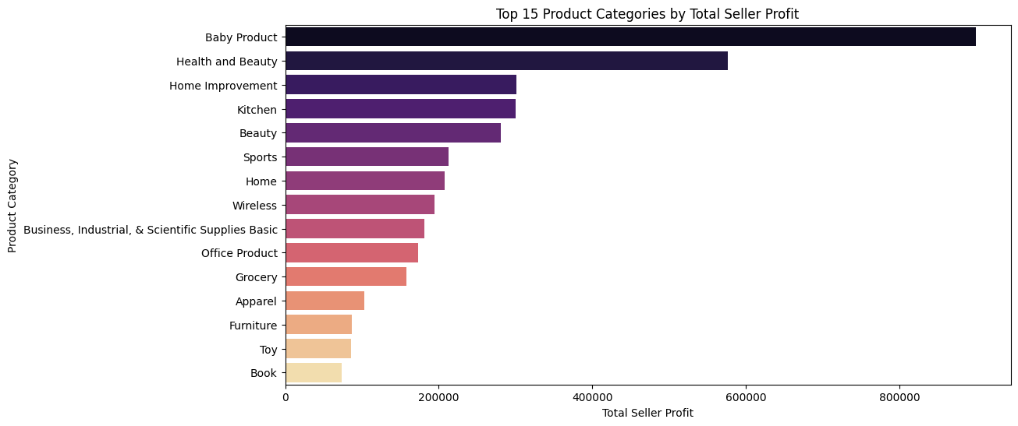
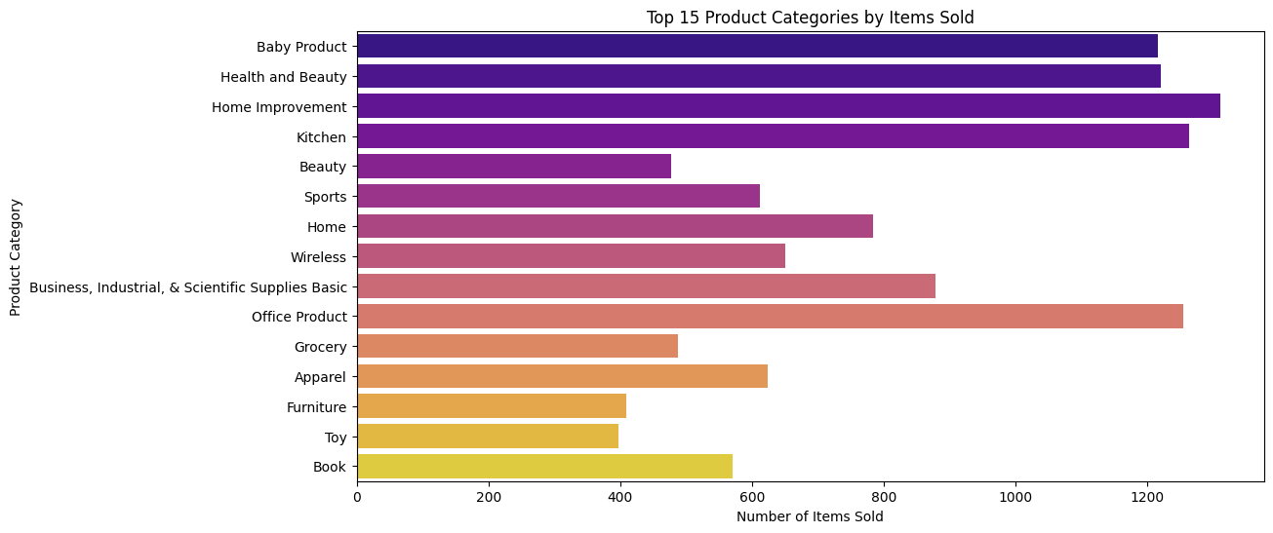

Slide 22
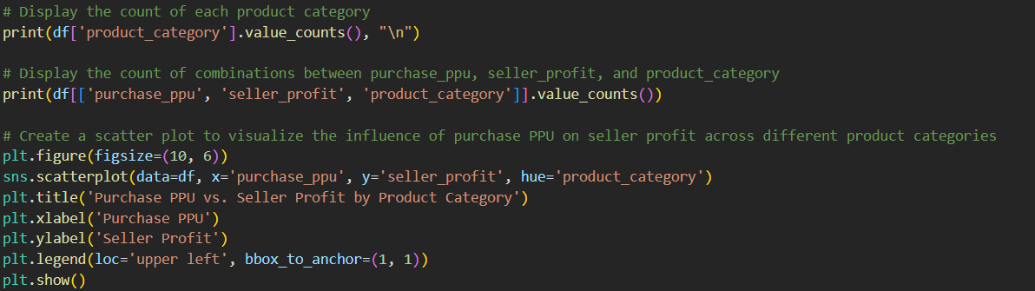
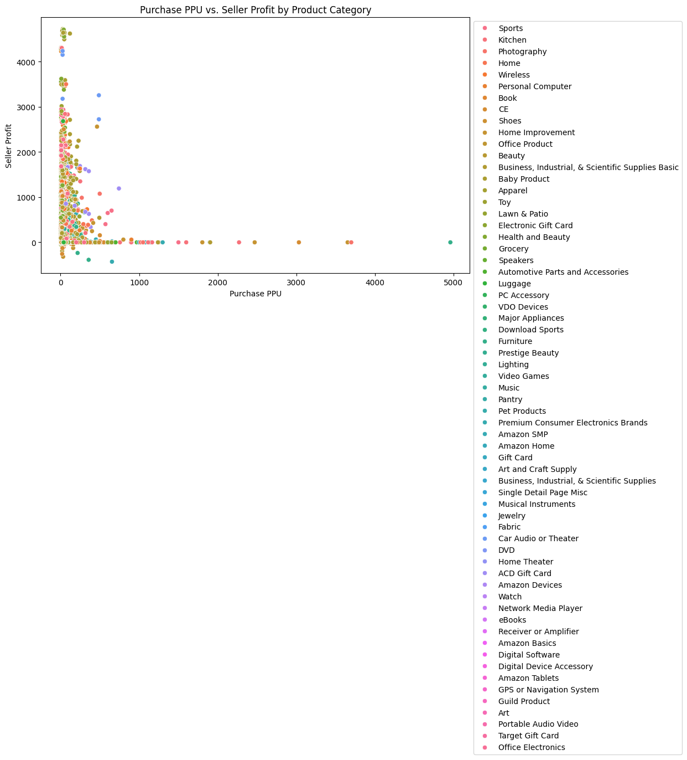
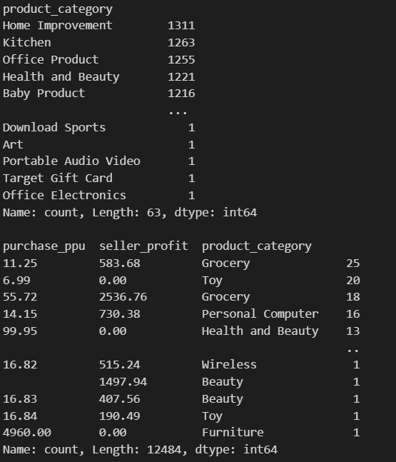
3) How does purchase PPU influence seller profit across different product category?

Slide 23
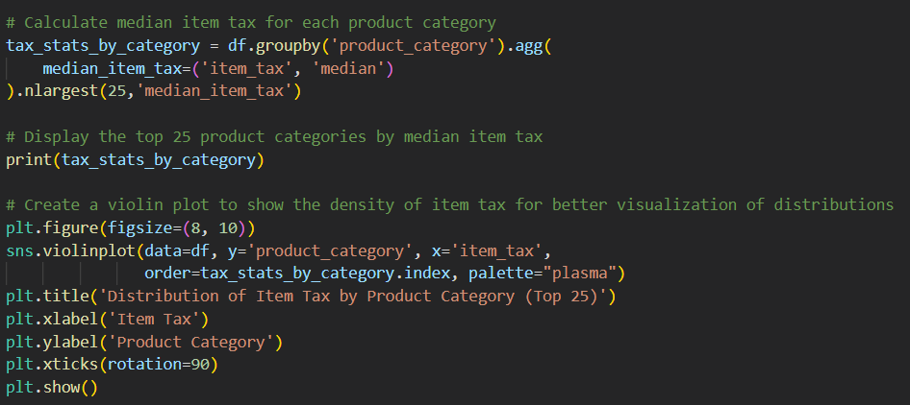
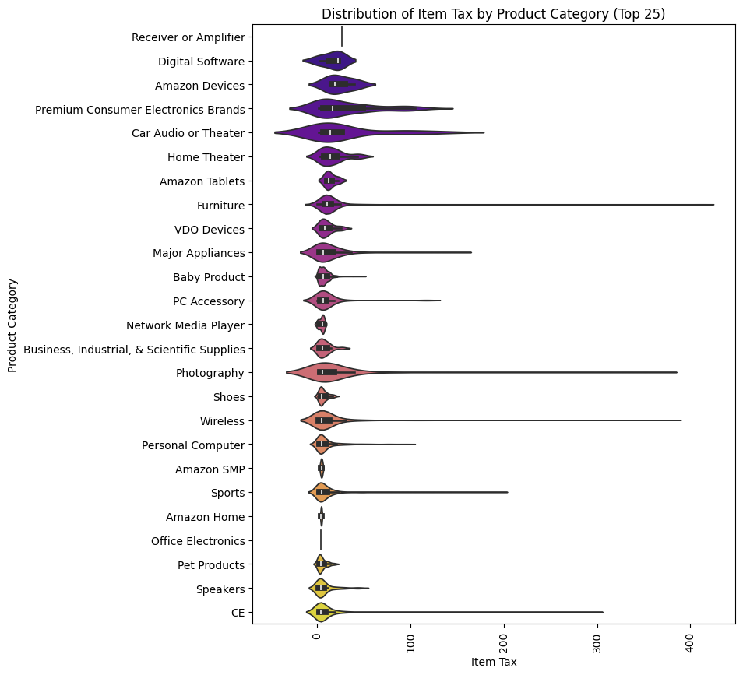
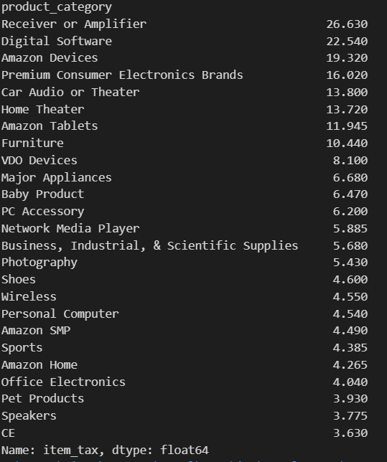
4) How does item tax vary across different product categories?

Slide 24



5) How do item shipping & handling costs vary across different manufacturers ?

Slide 25



6) What is the relationship between item tax and payment amount across different product categories?

Slide 26

7) How does order delivery time vary across different product categories and brands?

Slide 27





Slide 28



8) How do sales trends vary by day of the week?

Slide 29



9) How does the total number of items sold vary across different days of the week over time?

Slide 30



10) How does total seller profit vary across different days of the week over time?

Slide 31



11) How does the time to purchase (time_to_purchase) vary across product categories?

Slide 32



12) What is the trend of shipping and handling costs over time?

Slide 33


Slide 34




a) Detect & Handle Duplicates :
b) Train-Test Split & Detect & Handle NaNs :

Slide 35



c) Detect & Handle Outliers :

Slide 36





Slide 37








Slide 38






d) Encoding :

Slide 39





Slide 40




e) Scaling :
f) Save Processed Data :

Slide 41

Thanks!
https://www.linkedin.com/in/mina-tharwat-aa5a6323a
https://github.com/MinaTharwat93/Mid-Project---E-Commerce-Ecosystem.git

